Slide 1



Lecture 10: Introduction to Marketing
GAM110: Development Principles
BA(Hons) Game Development
BSc(Hons) Computing for Games

Slide 2
Learning Outcomes
Define the term marketing
Analyse marketing approaches for making and selling games
Develop approaches for assessing game commercial potential

Slide 3
‘In this session we will discuss marketing, a concept typically seen by many in game development as 'corporate' or 'too business'. It is, however, an incredibly creative and exciting part of the games industry, and one which is critical to reaching the people who you want following your game project and join your game’s ‘community’ as you develop and grow it.’
- From GAM110: Development Principles, Learning Space

Slide 4
Why are some games very successful?

Slide 5
Why are some games very successful?
GTA5
90 Million sales, $6BN revenue (2018)
https://www.trustedreviews.com/news/gta-5-now-profitable-entertainment-product-ever-3448487
https://www.marketwatch.com/story/this-violent-videogame-has-made-more-money-than-any-movie-ever-2018-04-06
WoW (MMO)
$9BN lifetime revenue (2017)
https://en.wikipedia.org/wiki/World_of_Warcraft
Fortnite
250M players
Raised Epic’s valuation from $825M (2012) to $8.5BN (2018)
https://en.wikipedia.org/wiki/Fortnite_Battle_Royale
Minecraft
Sold for $2.5BN (2014)
https://en.wikipedia.org/wiki/Minecraft

Slide 6
Why are some games absolute turkeys?

Slide 7
Why are some games absolute turkeys?
APB (MMO)
Duke Nukem Forever
Pac-man (Atari 2600)
ET (Atari 2600)

Slide 8
Zietgeist

Slide 9
Zeitgeist
‘the defining spirit or mood of a particular period of history as shown by the ideas and beliefs of the time’
Often, games will come along that define this

Slide 10
Zeitgeist

Slide 11
What does it mean for us as developers?

Slide 12
What does it mean for us as developers?
Would be nice to work on commercially successful and critically acclaimed games
There aren’t that many of them

Slide 13
What does it mean for us as developers?
Would be nice to work on commercially successful and critically acclaimed games
Lots of games companies struggle to remain in business

Slide 14



What does it mean for us as developers?
How many games get released, what does competition look like?’

Slide 15
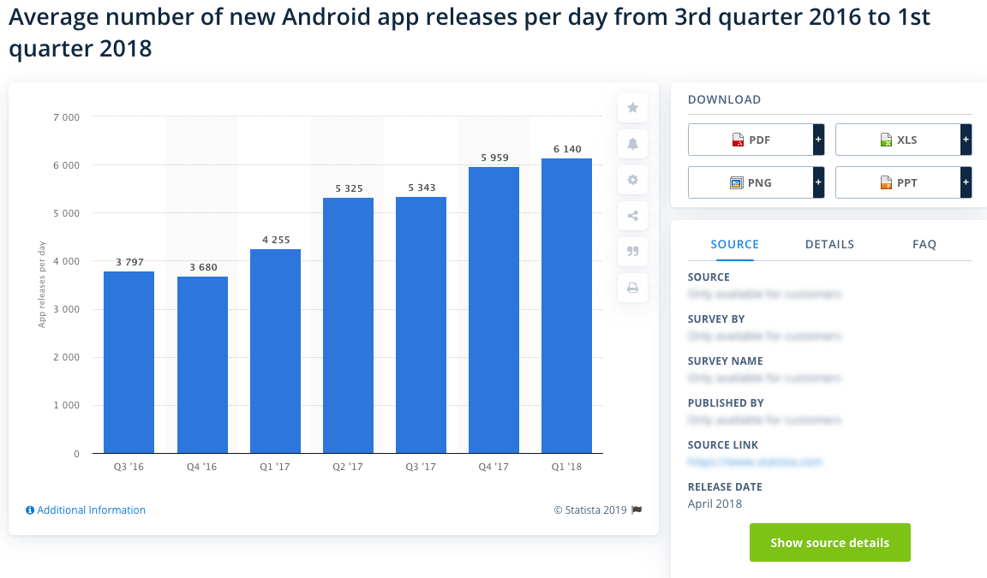
What does it mean for us as developers?
https://www.statista.com/statistics/276703/android-app-releases-worldwide/#:~:targetText=This%20statistic%20shows%20the%20average,Google%20Play%20Store%20every%20day.

Slide 16
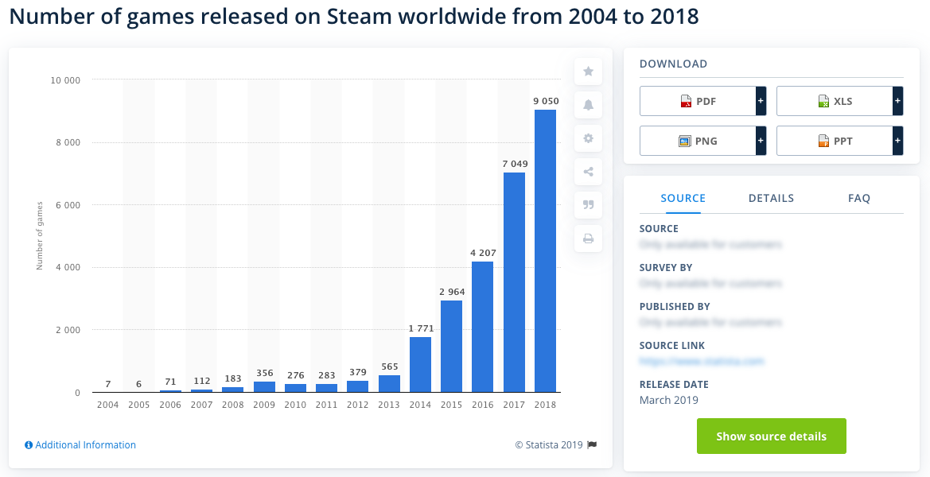
What does it mean for us as developers?
https://www.statista.com/statistics/552623/number-games-released-steam/

Slide 17
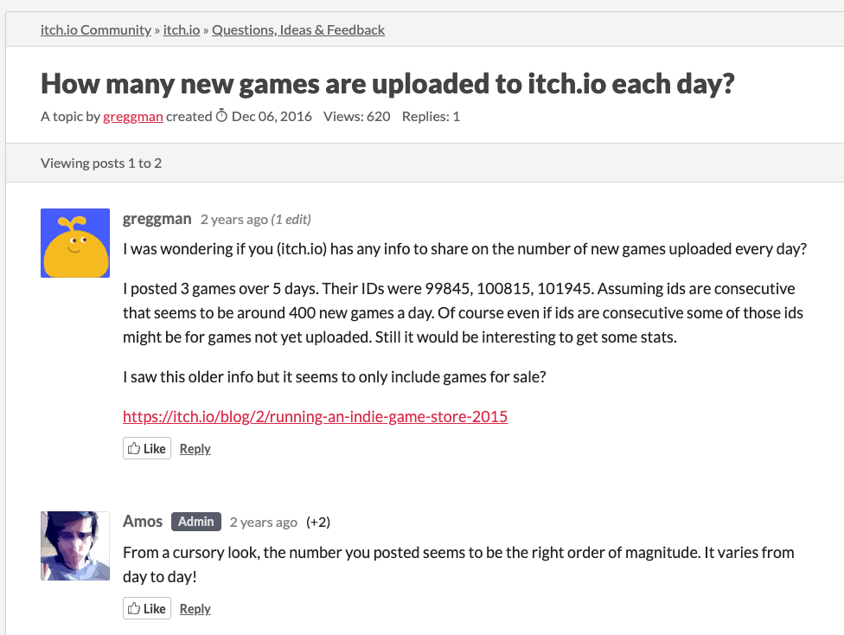
What does it mean for us as developers?
https://itch.io/t/50035/how-many-new-games-are-uploaded-to-itchio-each-day

Slide 18
What does it mean for us as developers?
As hobbyist developers, we can do whatever we want, it’s a hobby
As commercial developers we need to think very carefully about what we do:
How can we keep a business running that relies on selling games in markets of hundreds of new games every day?

Slide 19
The commerce of games development 101

Slide 20
The commerce of games development 101
Profit = revenue (sales) – costs
Generally:
people want to be paid for working
Suppliers want to be paid for their services (s/w, offices etc)
The least successful outcome, is to break even
You can re-use the revenue to do more work
The worst outcome is to lose money
Costs > revenue

Slide 21
The commerce of games development 101
Selling is therefor key
Who are you selling to?
Why are they going to buy and play your game?
How do you reach them to tell them what you are doing?
Where are you going to sell your games?
When will your game be available?
What are you selling (a game, loot boxes, monthly access etc) what is the product / service?

Slide 22
The commerce of games development 101
Selling is therefor key
Who are you selling to?
Why are they going to buy and play your game?
How do you reach them to tell them what you are doing?
Where are you going to sell your games?
When will your game be available?
What are you selling (a game, loot boxes, monthly access etc) what is the product / service?
This is the 5Ws&H model
https://en.wikipedia.org/wiki/Five_Ws
Who, where, why, what, when and how

Slide 23
The commerce of games development 101
Selling is therefor key
Who are you selling to?
Why are they going to buy and play your game?
How do you reach them to tell them what you are doing?
Where are you going to sell your games?
When will your game be available?
What are you selling (a game, loot boxes, monthly access etc) what is the product / service?
This is the 5Ws&H model
This is also the core of marketing

Slide 24
What marketing is and what marketing isn’t?

Slide 25
What marketing is and what marketing isn’t?
Three statements of doom from indie developers on Twitter:
‘We’ve finished making the game, now we need to work out what marketing is’
‘This is the game I’ve always wanted to make’
‘This game is for everyone, from 8 to 80’

Slide 26
What marketing is and what marketing isn’t?
‘We’ve finished making the game, now we need to work out what marketing is’
Developers often talk about PR, advertising and marketing interchangeably
Marketing – activities geared around defining products that an organisation will create, advertise and sell to defined groups of customers
Advertising – activities specifically linked to a product or service that you want to make customers interested in
Public Relations – activities that are linked to your business rather than a particular product or service, generally to build the good standing of your business

Slide 27
What marketing is and what marketing isn’t?
‘This is the game I’ve always wanted to make’
Developers (designers) often talk about what they want in a game
You are selling to a broader audience than just yourself

Slide 28
What marketing is and what marketing isn’t?
‘This game is for everyone, from 8 to 80’
Developers talk about inclusivity in games by meaning its for everyone
Is your appeal really that broad
If it is, how do you reach all those people?

Slide 29
Doing Marketing

Slide 30
Doing Marketing
Marketing as an activity encompasses all game development activities
Will normally start before development starts
Get a clear idea of what you are going to make and who it is for
And continue once it has finished (sales activities)
Sell to your intended customers
What you learn from marketing during development will help you better meet customer needs
New (competing) product announcement
Competing product feedback
New market opportunities

Slide 31
Doing Marketing
DEVELOPER
MARKET
WHY?
Will people play your game?
HOW?
Will you reach your customers?
POTENTIAL
CUSTOMERS
OTHER
PRODUCTS
WHO?
Are you making products for?
DEVELOPMENT
Making the game
WHEN?
Will your game be ready?
POTENTIAL
COLLABORATORS
WHERE?
Will you sell your games?
WHAT?
Are you selling?
POTENTIAL
COMPETITORS

Slide 32
Doing Marketing
Market Analysis
Evaluate competing / reference products to find key features through reviews and play testing
Determine who your key customers (markets) are
Evaluate competing / reference product revenues / user base
Market Research
See what potential customers want and need in games
See what reviewers want to see in games
See what rival games are in development
User Testing
See what potential customers think of your game in development
Undertake A/B testing to evaluate features / approaches
Community management
Build a group of interested and excited early adopters
Use them for market research & user testing

Slide 33
Conclusions
Some games are very successful, generally because they capture the zeitgeist
This is very hard to plan for
The games market is far bigger than these hyper successful outliers
To have a successful games business
You need to only make sure you can recoup your costs
You wont go bust, but you wont grow

Slide 34
Conclusions
Games that fail commercially generally do because they fail to follow the 5Ws&H for their games
Make products that people are not interested in
Not doing adequate research to address that
This is generally true for all businesses
To have a sustainable business:
You have to make products and services that people want and are prepared to pay for
And you have to at least cover the costs of making and selling your products
[this isn’t necessarily the case of some start-ups that are looking to buy market share through low pricing (Uber), but they have a different agenda]

Slide 35
Questions?

